Slide 1

Predicting Flight Ticket Prices Using Machine Learning"
Mounikesh Goud Bairagoni
Notes:
Good morning everyone! We are excited to present our project on ‘Predicting Flight Ticket Prices Using Machine Learning.’ We are Group 5, and our team members are:"

Slide 2
Project Vision and Goal
Predict future flight ticket prices using machine learning based on historical trends.
Use Amadeus API to retrieve historical flight price data for LHR-CDG, CDG-AMS, and LHR-AMS routes.
Implement an ETL pipeline to extract, transform, and load raw API data.
Leverage Azure Data Factory for ingestion, Azure Databricks for transformation, and ADLS for storage.
Perform feature engineering on departure date, route, seasonality, and holidays.
Visualize trends and insights using Power BI dashboards.Train forecasting models such as ARIMA, Facebook Prophet, XGBoost Regression, and LSTM.
Incorporate time-based patterns, holidays, and external factors into the model.
Evaluate model accuracy using MAE and RMSE metrics.
Deliver a cloud-based system to help users make data-driven travel and pricing decisions.
Notes:
Project Overview – Flight Price Prediction
🔹 Goal: Predict future flight ticket prices using machine learning, enabling users to make informed travel decisions and find the best deals.
🔹 Data Collection: ✔ Amadeus API provides historical price data for routes: LHR-CDG, CDG-AMS, LHR-AMS. ✔ Real-world data ensures accuracy in model training.
🔹 ETL Pipeline (Data Processing): ✔ Extract: Retrieve raw pricing data from Amadeus API. ✔ Transform: Clean, structure, and engineer relevant features. ✔ Load: Store in Azure Data Lake Storage (ADLS) for analysis. ✔ Tools Used: Azure Data Factory (ingestion), Azure Databricks (transformation).
🔹 Key Price Influencing Factors: ✔ Departure Date & Route: Different routes and dates impact prices. ✔ Seasonality: Peak and off-peak seasons affect ticket costs. ✔ Holidays & External Factors: Events like Christmas increase demand.
🔹 Machine Learning Models Used: ✔ ARIMA: Statistical time-series forecasting. ✔ Facebook Prophet: Captures seasonality and trends. ✔ XGBoost Regression: Effective for structured data prediction. ✔ LSTM: Deep learning for sequential data analysis.
🔹 Performance Evaluation: ✔ MAE (Mean Absolute Error): Measures average prediction error. ✔ RMSE (Root Mean Squared Error): Highlights larger errors for better accuracy.
🔹 Visualization & Insights: ✔ Power BI Dashboards: Displays price trends and insights. ✔ Cloud-Based System: Provides real-time, data-driven price predictions.
✅ Impact: Helps travelers and agencies make cost-effective booking decisions using AI and cloud-based technologies. 🚀

Slide 3

Data Source : Amadeous Api
Amadeus for Developers provides access to real-time and historical flight data.
Used the Flight PriceSearch API to retrieve past flight prices for major European routes like LHR-CDG, CDG-AMS, BCN-FCO,
Data includes:Origin & destinationDeparture datePricing details by class (economy, business, etc.)
Transport type, one-way/both-way indicators
REST API with OAuth 2.0 authenticationSupports pagination, parameterization, and flexible search filters
Notes:
Amadeus API – Data Source
🔹 Why Amadeus API? Provides real-time & historical flight data, widely used for aviation insights.
🔹 Data Retrieved: ✔ Past flight prices for key European routes (LHR-CDG, CDG-AMS, BCN-FCO). ✔ Origin & destination, departure date, pricing by class, transport type, trip type.
🔹 Technical Features: ✔ REST API with OAuth 2.0 for secure access. ✔ Pagination & Filters for efficient data retrieval.
🔹 Additional Features: ✔ Flexible Search Parameters – Filter data based on airline, class, and date range. ✔ Comprehensive Coverage – Access to global flight data for diverse predictions. ✔ Scalability – Handles large datasets, making it ideal for machine learning applications. ✔ Real-time & Historical Data – Enables both trend analysis and real-time price monitoring.
✅ Why It Matters? Offers accurate, flexible data for predicting flight prices effectively and enhancing travel decision-making.

Slide 4
Security Practices and Secret Management
Azure Key Vault is used to securely store credentials (client_id, client_secret)
Managed Identity (MSI) enables ADF to access secrets without hardcoded credentials
Secrets are fetched using Web activitiesSensitive outputs are secured via:secureOutput: truesecureInput: true
Token exchange happens securely with:POST https://test.api.amadeus.com/v1/security/oauth2/token
Notes:
Security Practices & Secret Management
🔹 Azure Key Vault stores credentials securely (client_id, client_secret). 🔹 Managed Identity (MSI) allows ADF to access secrets without hardcoded credentials. 🔹 Web Activities fetch secrets dynamically, ensuring secure handling. 🔹 secureOutput: true & secureInput: true protect sensitive data from exposure. 🔹 OAuth 2.0 Token Exchange ensures secure API authentication via: 📌 POST https://test.api.amadeus.com/v1/security/oauth2/token
✅ Outcome: Prevents unauthorized access, protects secrets, and ensures a secure workflow.

Slide 5
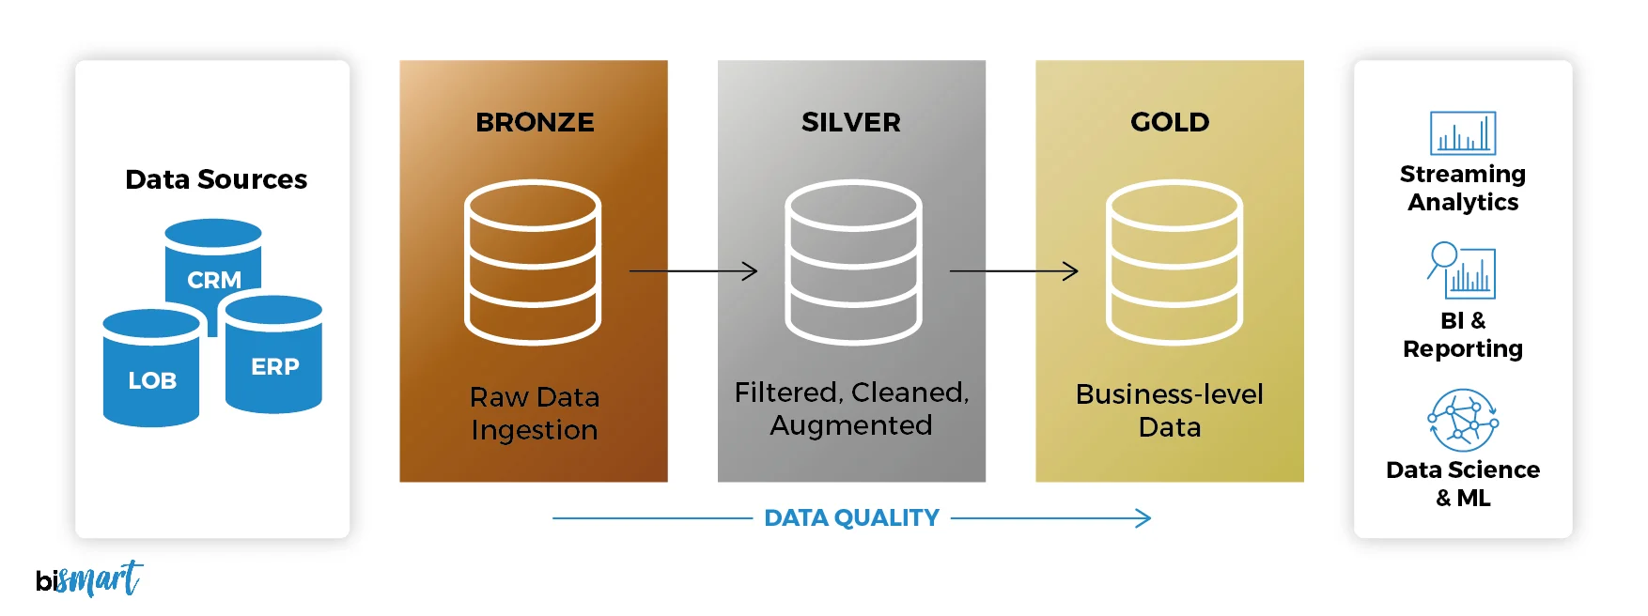
Medallion Architecture:
Bronze Layer (Raw Data)
Stores raw data directly from sources (e.g., APIs, logs).
No cleaning or validation.
Used for backup and audit.
Silver Layer (Cleaned Data)
Cleans and transforms bronze data.
Removes duplicates, fixes types, joins tables.
Ready for basic analysis and modeling.
Gold Layer (Business Data)
Aggregated and enriched data.
Used in dashboards, reports, and ML models.
Trusted, business-ready data.
Notes:
Bronze Layer (Raw Data)
Stores raw data directly from sources (e.g., APIs, logs).
No cleaning or validation.
Used for backup and audit.
Silver Layer (Cleaned Data)
Cleans and transforms bronze data.
Removes duplicates, fixes types, joins tables.
Ready for basic analysis and modeling.
Gold Layer (Business Data)
Aggregated and enriched data.
Used in dashboards, reports, and ML models.
Trusted, business-ready data.

Slide 6
Ingestion Workflow Overview
Pipeline Name: EXTRACTION_FLIGHTS
Steps:
Retrieve Secrets → from Key Vault
Generate Access Token → via Web activity
Loop over Dates → using a ForEach loop
Set Dynamic Date → via SetVariable activity
Call Amadeus API → using Copy activity with headers and query params
Write to ADLS → in JSON format, partitioned by month and year
Notes:
1. Retrieve Secrets
Uses Azure Key Vault to fetch secrets (like API keys, client ID, and client secret).
Ensures sensitive data is managed securely.
2. Generate Access Token
Uses a Web activity to call the token endpoint of the Amadeus API.
Sends client_id and client_secret to obtain a Bearer Token.
This token is required for authenticating further API calls.
3. Loop Over Dates
Implements a ForEach loop to iterate over a date range.
Enables the pipeline to extract data for multiple dates (e.g., daily flight info).
4. Set Dynamic Date
Uses a SetVariable activity inside the loop to dynamically create the date value for that iteration.
This dynamic date is later used as a query parameter in the API call.
5. Call Amadeus API
Uses a Copy Data activity to call the Amadeus API.
Sends headers (Authorization: Bearer <token>) and query parameters (like the date).
Retrieves flight data for the current date in the loop.
6. Write to ADLS
Writes the retrieved data to Azure Data Lake Storage.
Stores it in JSON format, organized (partitioned) by:
Month
Year

Slide 7
Copy Activity: API to ADLS
Content:
Source:
Type: RestSource
Method: GET
Token: Passed via Authorization: Bearer <access_token>
Pagination: RFC 5988 supported
Sink:
Format: JSON
Destination: Azure Data Lake Storage Gen2
Path includes: origin, destination, retrivedmonth, DATEEE, FISCALYEAR
Parameters passed:
retriveddate → from variable
origin, destination → from pipeline parameters
Retries & Timeout:
Retries: 10 times
Timeout: 12 hours
Interval: 30 seconds
Notes:
Source (API Details):
The data source is a REST API, configured using a RestSource type.
API calls are made using the GET method, which is used to retrieve data (read-only).
Authentication is handled securely using a Bearer token, passed through the HTTP header
Follows RFC 5988 (Web Linking) standard to handle multiple pages of data automatically.
Sink (Target Storage Location):
The API response data is stored in Azure Data Lake Storage Gen2, which is a scalable and secure data lake.
Data is written in JSON format, making it easy to parse and analyze later.
The file path used for storing the data includes
origin
destination
retrivedmonth
DATE
FISCALYEAR
Parameters Passed to API:
retriveddate:
This value is dynamically fetched from a variable
origin and destination:
These are passed directly from the pipeline parameters to allow flexible use for different source-destination pairs.
Retries and Timeout Handling:
The API is configured to retry up to 10 times in case of failure or network issues.
A timeout of 12 hours is set for the full operation to ensure long-running tasks can complete.
Between retries, the system waits for 30 seconds before attempting the next call, helping manage temporary issues like rate limiting or connectivity.

Slide 8
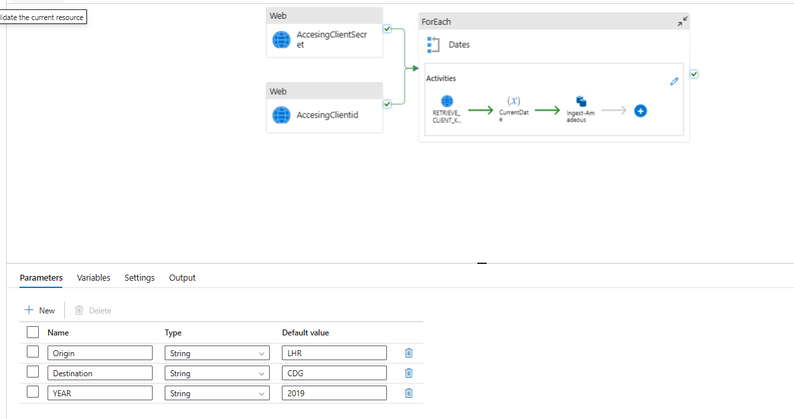
Extraction
Notes:
Authentication via Web Activities:
Here we Have Two Web activities
AccessingClientSecrets
AccessingClientId
These are used to authenticate and retrieve an access token from a REST API.
First activity gets the client secret.
Second activity gets the client ID.
By using client secret and ClientID they form the authorization token used in later REST API calls.
ForEach Activity (Looping Through Dates):
It calls a REST API using the parameters
Then copies or processes the data
Lastly, stores the output in a sink

Slide 9
Transformation1-Secure Access via Key Vault & OAuth
Purpose
To securely authenticate Apache Spark in Databricks for accessing Azure resources like ADLS Gen2, without exposing credentials in the code.
Key Components:
Azure Key Vault: Stores secrets like Client ID, Client Secret, and Token Endpoint.
Databricks Secret Scope: Enables secure access to Key Vault from notebooks.
OAuth2: Authenticates via token-based access for enterprise-grade security.
Grants token-based access to ADLS without storing credentials in code.
Result
Secure, token-based access to Azure Data Lake Gen2.
Credentials are never exposed or hardcoded.
Aligns with enterprise security best practices.

Slide 10
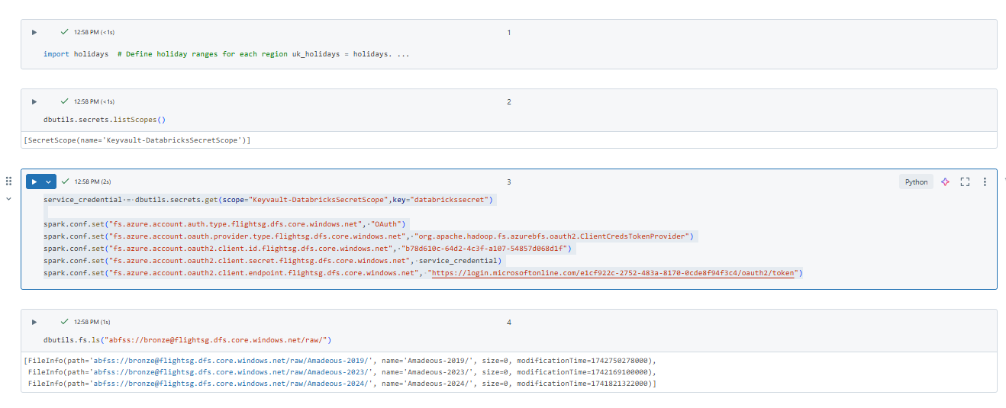

Slide 11
Transformation1-Data Loading and Merging
This process automates the loading of monthly flight pricing data stored in Azure Data Lake Storage Gen2 (ADLS Gen2) and merges it into one dataset for analysis.
A loop runs through all 12 months, dynamically constructing the file path using the origin, destination, and year.
zfill(2) is used to format the month numbers (e.g., 1 becomes 01) to match folder names.
For each month:
Spark tries to read the JSON file using spark.read.format("json").
If the file is missing or malformed, the script skips it without failing, using try-except.
All successfully read DataFrames are appended to a list and then merged using .union().
The final merged DataFrame contains clean, combined data, ready for transformation or modeling.
Example result: 345 valid records aggregated for the selected route and year.
This approach ensures automation, fault tolerance, and scalability in data ingestion workflows.

Slide 12
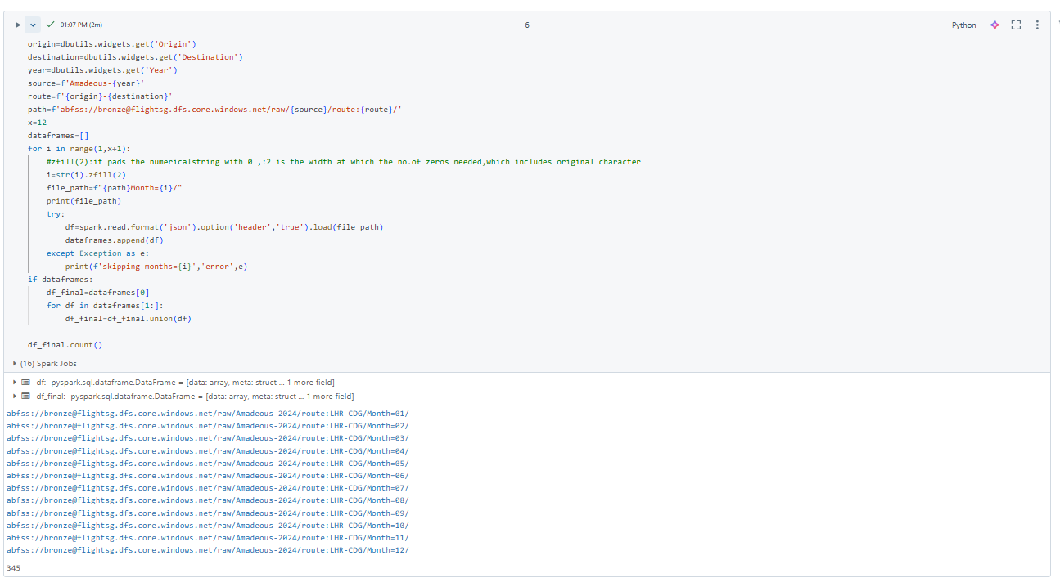
Transformation1-Data Loading and Merging

Slide 13
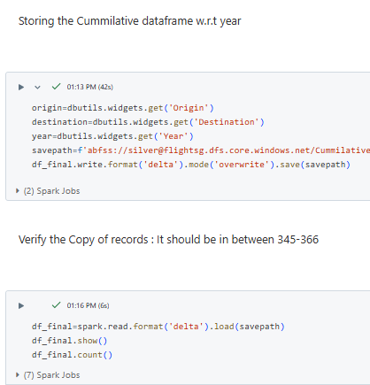
Transformation1:Writing to Delta Lake
Purpose
To save the final, cleaned DataFrame in a structured and queryable format that supports large-scale data analytics and ensures data reliability.
Saves the merged DataFrame to Delta format using .write.format("delta")
The save path is constructed dynamically using Origin, Destination, and Year
Uses 'overwrite' mode to refresh old data
Target path: abfss://silver@flightsg.dfs.core.windows.net/ Cumulative_routes/{origin}-{destination}/{year}

Slide 14
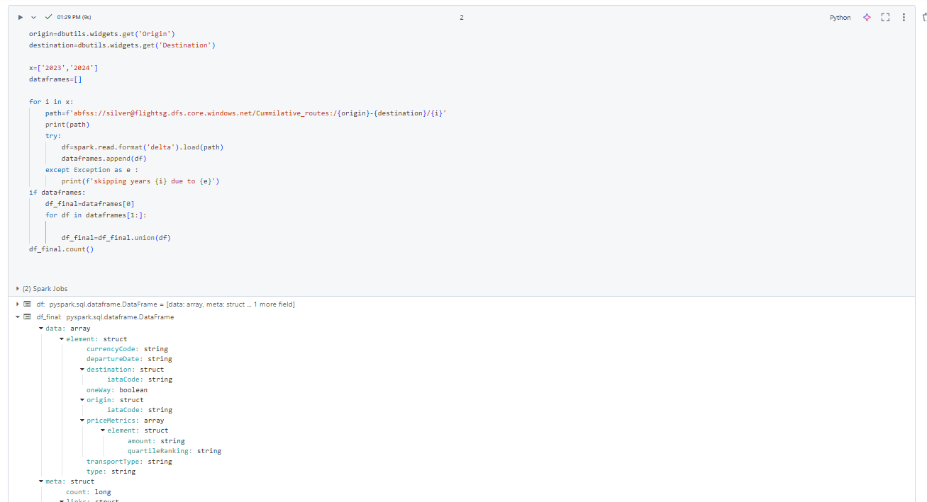
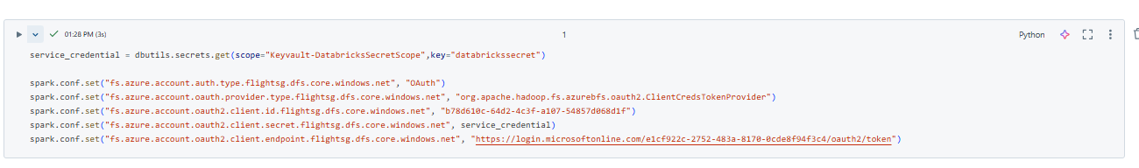
Transformation2: Secure Access & Delta Data Ingestion
Authentication is handled via Azure Key Vault-backed secrets and OAuth2
Access granted securely to ADLS Gen2 using Spark config
Origin and Destination are passed via widgets
Iterates through 2023 and 2024 to read cumulative Delta files
Uses try-except to handle missing data or corrupt files
Combines all years into one unified DataFrame using union()

Slide 15
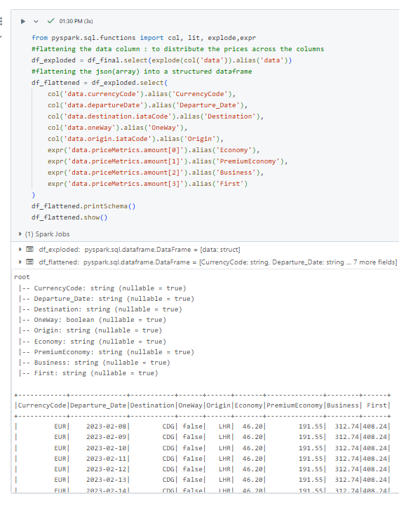
JSON Transformation & Price Flattening
Uses explode() to flatten array column 'data'
Parses nested JSON structure into meaningful fields:
- CurrencyCode, Departure_Date, Origin, Destination, OneWay
- Price classes: Economy, PremiumEconomy, Business, First
Extracts prices from 'priceMetrics.amount' array using expr()
Final structured schema is ready for validation

Slide 16
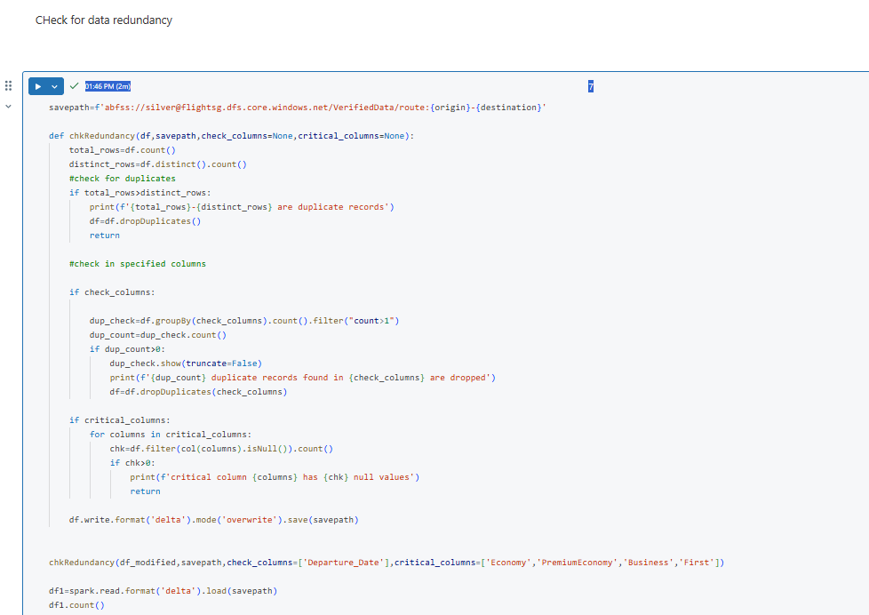
Redundancy Check & Conditional Save
Custom function chkRedundancy checks:
Duplicate records in key columns (e.g., Departure_Date)
NULL values in critical columns like Economy, Business
If issues are detected, file is not saved
If clean, data is written to:
abfss://silver@flightsg.dfs.core.windows.net/VerifiedData/route:{origin}-{destination}
Ensures only high-quality, validated data is stored

Slide 17
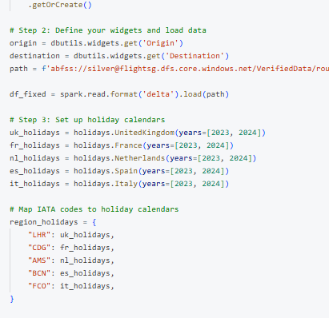
Transformation 3 :Holiday Calendar Integration
Holiday calendars are initialized for:
United Kingdom (LHR), France (CDG), Netherlands (AMS), Spain (BCN), Italy (FCO)
Mapped to corresponding IATA airport codes.
Two custom UDFs are defined:
1. `is_holiday_udf` Returns True if `departure_date` is a holiday for a given region.
2. `holiday_name_udf` – Returns the holiday name for the given region and date.
Adds four new columns to DataFrame:
is_origin_holiday
is_destination_holiday
origin_holiday_name
destination_holiday_name

Slide 18
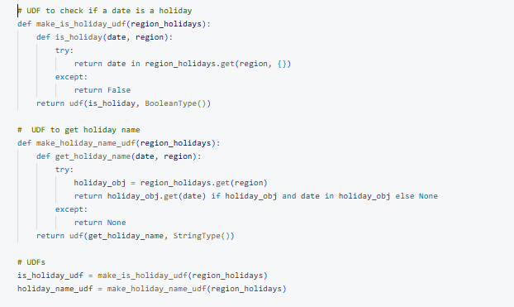
Transformation 3 : UDF Creation & Holiday Column Generation
• Custom UDFs created:
1. `is_holiday_udf` – checks if a given `departure_date` is a holiday for a region.
2. `holiday_name_udf` – retrieves the holiday name based on region and date.
• These UDFs rely on the `holidays` Python package, with calendars mapped by IATA codes.
• Enrichment columns added:
- is_origin_holiday
- is_destination_holiday
- origin_holiday_name
- destination_holiday_name
• Logic is applied per row using:
df_fixed.withColumn(...).withColumn(...)

Slide 19
Transformation3:Final Holiday-Based Features & Output
Custom UDFs Defined:
is_holiday_udf: Checks if a given departure_date is a holiday in a region.
holiday_name_udf: Returns the name of the holiday, if any.
New Columns Added:
is_origin_holiday: Flag if departure date is a holiday at the origin airport.
is_destination_holiday: Flag if it's a holiday at the destination.
origin_holiday_name and destination_holiday_name: Provide actual holiday names.
Derived Features:
is_holiday_route: Combines both flags to indicate if either location is on a holiday.
holiday_name: Merges origin/destination holiday names using coalesce() to get a single value.

Slide 20
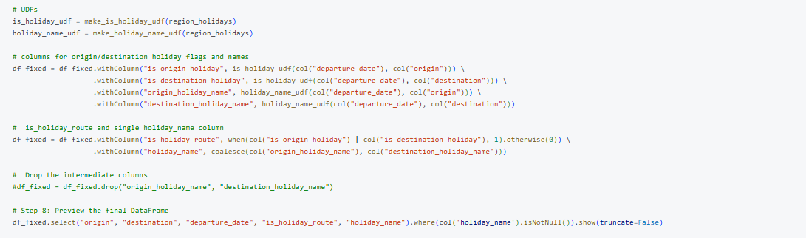

Slide 21
DataModelling-StarSchema
The data loaded into the factual table has been normalized into separate fact and dimension tables.
The fact table captures transit-related information, including the origin, destination, fare prices across travel classes (First, Economy, and Premium Economy), and holiday indicators associated with the travel date.
From this fact table, the following dimension tables are derived:
Date Dimension: Provides detailed breakdowns of travel dates.
IATA Codes Dimension: Contains metadata for origin and destination airport codes.
Currency Dimension: Includes currency details used in fare calculations.
Holiday Dimension: Stores holiday-related information contextualized by country.
These tables are connected through appropriate foreign key relationships with the fact table, forming a Star Schema structure for efficient querying and analysis.

Slide 22
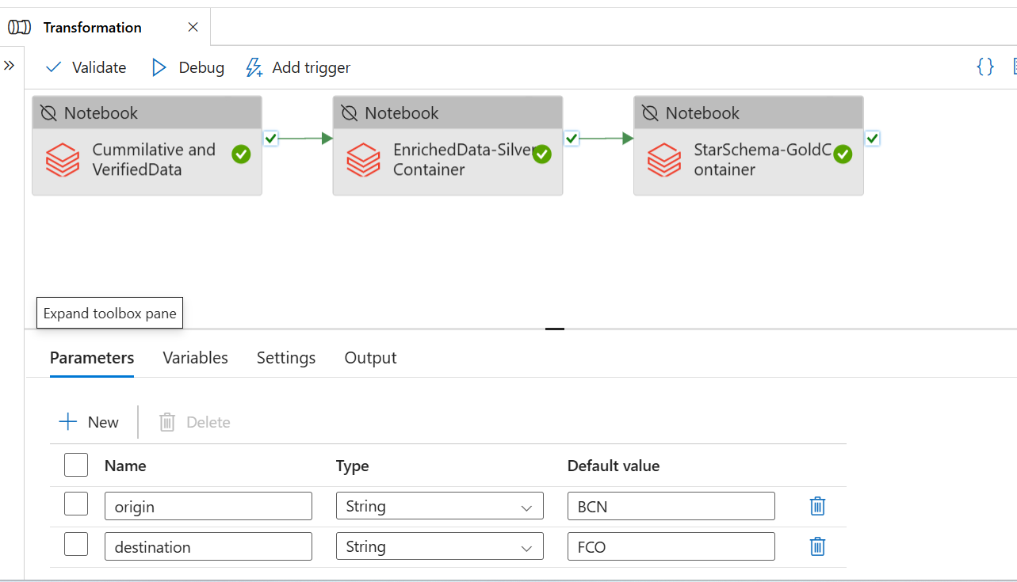

Slide 23
Optimized Data Export Workflow
Due to budget constraints associated with managing data in cloud storage, we decided to export our data to SQL Server for more cost-effective processing and analysis.
However, exporting data in the conventional CSV format posed limitations, particularly around the lack of support for data types and schema enforcement.
To address this, we transitioned from using Delta format to Parquet format, which inherently supports schema preservation.
As a result, the converted files from the Delta Fact Table were stored in Parquet format within the Gold container at the following
'abfss://gold@fligjhtsg.dfs.core.windows.net/StarSchema/FactsParquet/Fact_Flight:{origin}-{destination}
This approach ensures data integrity during export and allows seamless ingestion into SQL Server with appropriate data types

Slide 24
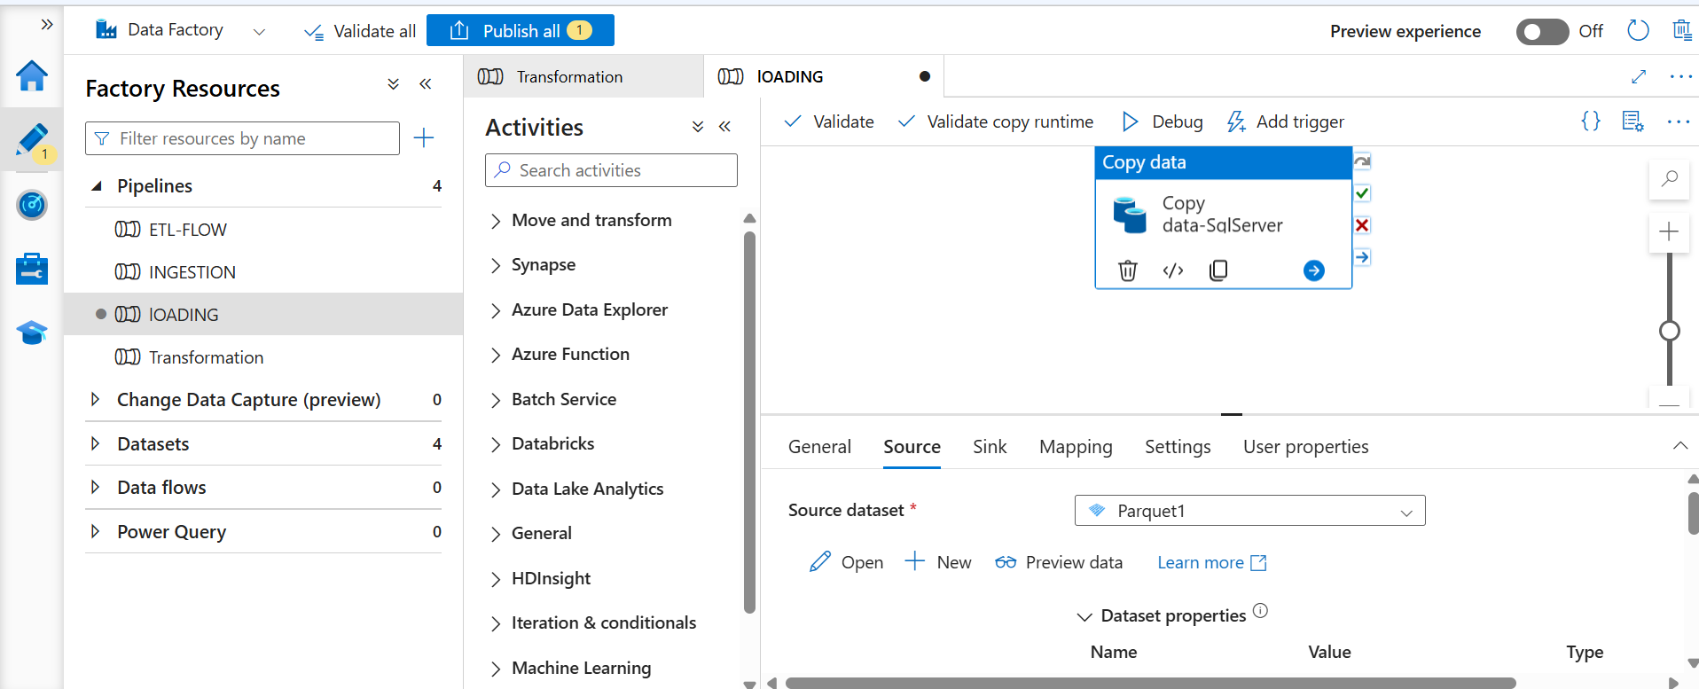

Slide 25
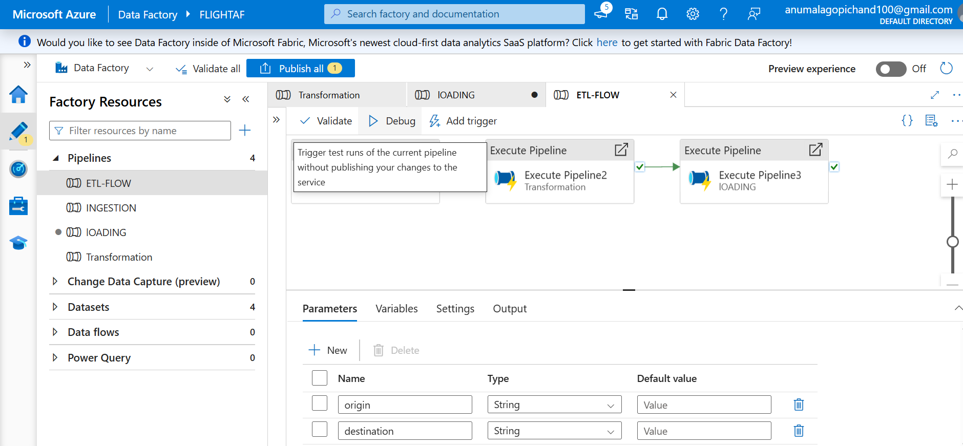
Complete ETL Pipeline

Slide 26
Initial ML Pipeline Flow
Objective: Predict future price increases and derive optimal fares across travel classes.
Input: Structured dataset from Data Lake (Delta → Parquet → SQL Server)
ML Pipeline Flow:
Data Extraction – from flight database
Preprocessing – date parsing, feature engineering, handling missing values
Feature Generation – derive route-level averages, percent changes
Forecast Modeling – train separate models for each fare class
Model Export – save trained models as .pkl files for inference
This process enables dynamic pricing insights based on time, location, and holiday factors.

Slide 27
Feature Pipeline – Engineering & Transformation
Engineered Features:
days_until_departure – time until flight
month, year, day_of_week – extracted from Departure_Date
holiday_flag – sum of origin, destination, and route holiday indicators
pct_change_* – price deviation from monthly route average
Forecast Logic:
forecasted_increase = clip(pct_change + holiday_adjustment)
optimal_price = base_price × (1 + forecasted_increase)
Data Cleaning:
Add jitter to avoid ties
Handle missing data with SimpleImputer

Slide 28
Model Training with RandomForestRegressor
For Each Fare Class:
Filter valid rows with required values
Ensure sufficient variance in target (forecasted_increase)
Select numerical features
ML Pipeline Setup:
SimpleImputer → replaces missing values
StandardScaler → normalizes features
RandomForestRegressor → ensemble-based regression model
Training Specs:
80/20 train-test split
100 trees (n_estimators=100)
Seeded for reproducibility (random_state=42)

Slide 29
Model Outputs and Deliverables
Trained Models (Per Fare Class):
Saved as .pkl files (Economy, PremiumEconomy, Business, First)
Forecast Outputs:
Forecasted Price Increase %
Optimal Fare Price
Use Cases:
Fare comparison tools
Alert systems for "good deals"
Predictive pricing dashboards
Storage Location:
Models saved in: model/{fare}_model.pkl

Slide 30
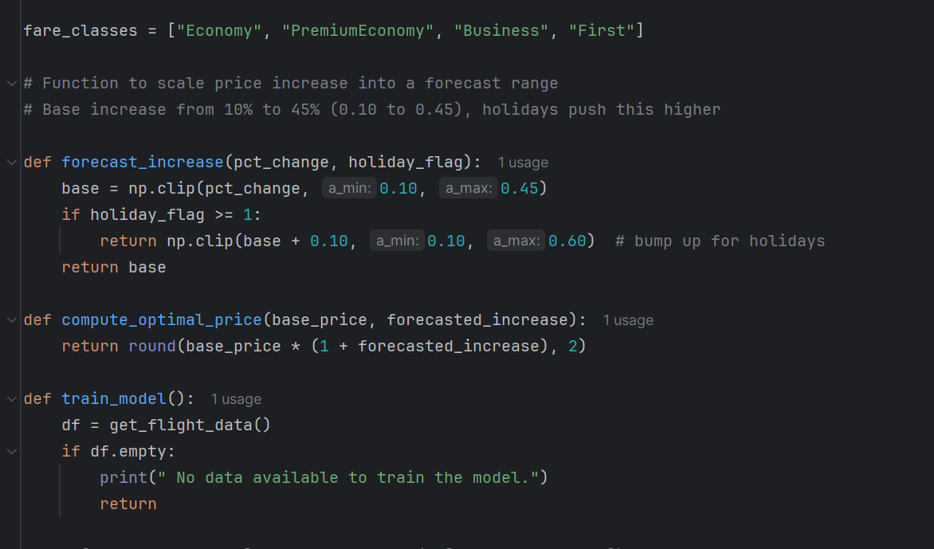
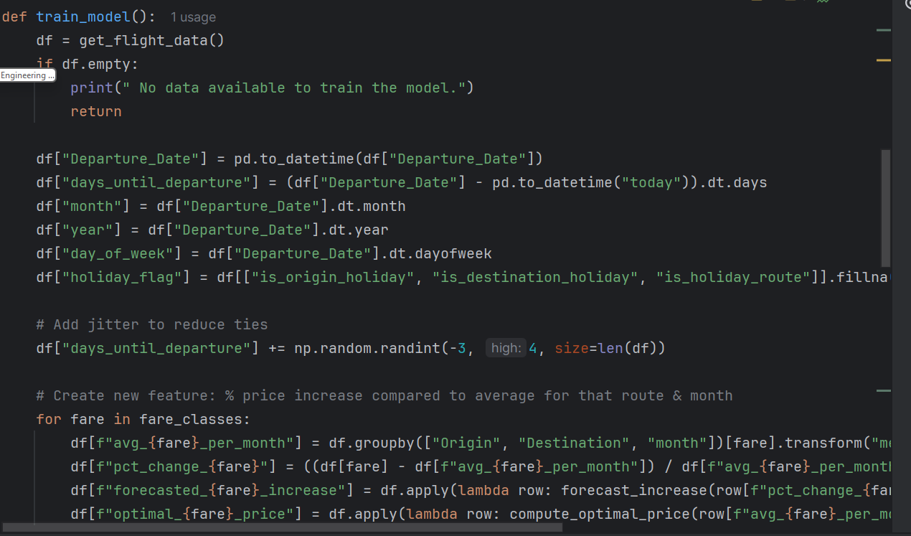
Code Snippets : Forecast Increase and model tarin

Slide 31
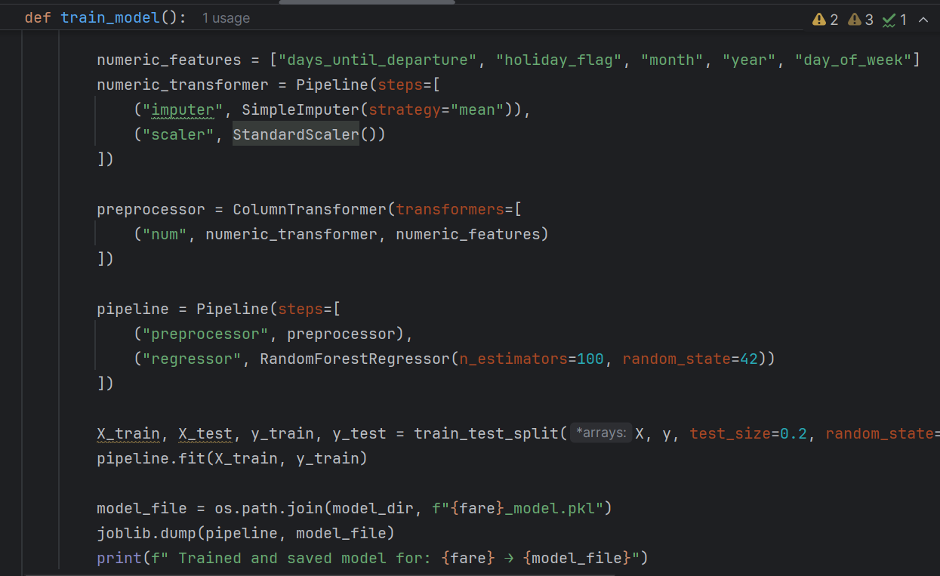
Cont…

Slide 32
Flight Deal Predictor Application-workflow
Predict if a given flight price is a good deal and display optimal fare forecasts for future dates.
Architecture Summary:
Frontend: HTML Forms (form.html) to collect user input
Backend: Python Flask App with trained ML models (RandomForestRegressor)
Visualization: Forecast chart generated using Matplotlib
Data Source: Historical fares from SQL-based flight database
Functionality:
Loads ML model for selected fare class
Predicts price increases over time
Calculates optimal prices
Determines if current price is a “Good Deal”

Slide 33

Input Parameters & Forecasting Logic
User Inputs and Forecast Calculation
User Inputs via Form:
Origin: Departure airport (IATA code)
Destination: Arrival airport (IATA code)
Fare Class: Economy, PremiumEconomy, Business, or First
Booking Date: Date of ticket purchase
Travel Date: Intended flight date
Price: Ticket price user is considering
Forecasting Logic:
Calculate days_until_departure
Derive forecast windows: +0, +15, +45, +60, +90 days
For each date, build feature set:
Days before departure
Holiday flag
Month, Year, Day of Week
Predict price increase % using trained model
Multiply by average route fare to get forecasted prices

Slide 34

Outputs – Deal Evaluation & Visualization
Model Outputs and User Feedback
Forecast Outputs Returned to User:
Forecasted Prices (at 15, 45, 60, and 90 days before travel)
Optimal Price among predicted values
Is It a Good Deal?
Yes, if user price < optimal price
No, otherwise
Visual Output:
Matplotlib chart:
X-Axis: Days Before Departure
Y-Axis: Predicted Optimal Price
Line Plot with markers
Template Rendered: result.html – Displays prediction results, forecast table, and line chart image

Slide 35
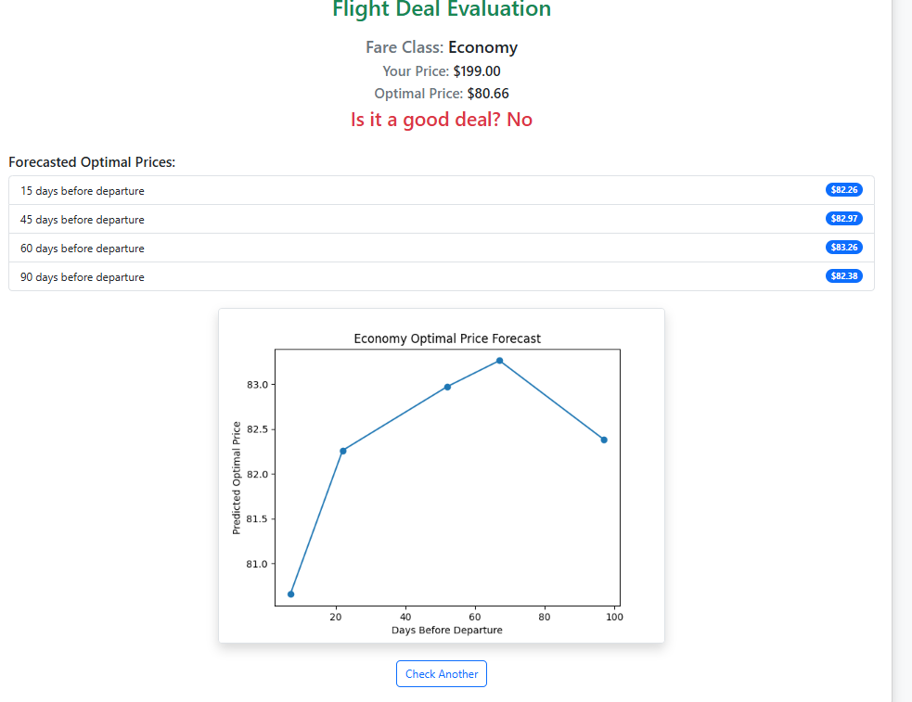
Appendix

Slide 36
Thank You

